Slide 1
NAT技术

Slide 2
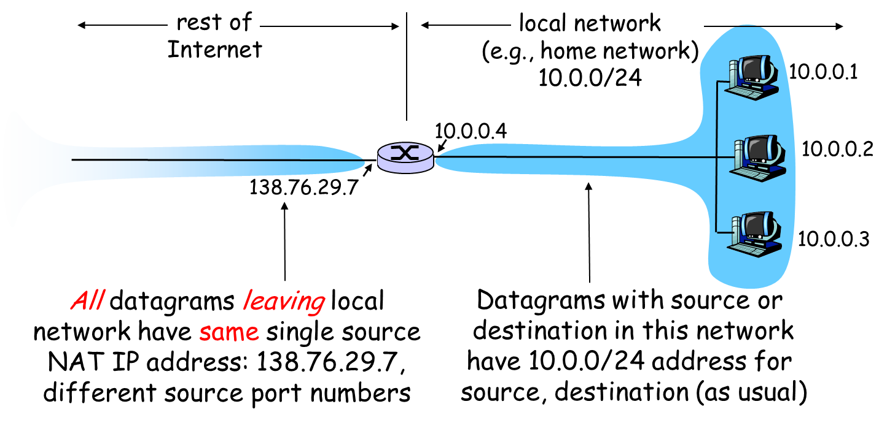
NAT: Network Address Translation

Slide 3
NAT: Network Address Translation
Motivation: local network uses just one IP address as far as outside world is concerned:
range of addresses not needed from ISP: just one IP address for all devices
can change addresses of devices in local network without notifying outside world
can change ISP without changing addresses of devices in local network
devices inside local net not explicitly addressable, visible by outside world (a security plus).

Slide 4
NAT: Network Address Translation
Implementation: NAT router must:
outgoing datagrams: replace (source IP address, port #) of every outgoing datagram to (NAT IP address, new port #)
. . . remote clients/servers will respond using (NAT IP address, new port #) as destination addr.
remember (in NAT translation table) every (source IP address, port #) to (NAT IP address, new port #) translation pair
incoming datagrams: replace (NAT IP address, new port #) in dest fields of every incoming datagram with corresponding (source IP address, port #) stored in NAT table

Slide 5
NAT: Network Address Translation
NAT translation table
WAN side addr LAN side addr
1: host 10.0.0.1
sends datagram to
128.119.40.186, 80
2: NAT router
changes datagram
source addr from
10.0.0.1, 3345 to
138.76.29.7, 5001,
updates table
138.76.29.7, 5001 10.0.0.1, 3345
…… ……
S: 10.0.0.1, 3345
D: 128.119.40.186, 80
10.0.0.1
1
2
S: 138.76.29.7, 5001
D: 128.119.40.186, 80
10.0.0.4
10.0.0.2
138.76.29.7
S: 128.119.40.186, 80
D: 10.0.0.1, 3345
4
S: 128.119.40.186, 80
D: 138.76.29.7, 5001
3
4: NAT router
changes datagram
dest addr from
138.76.29.7, 5001 to 10.0.0.1, 3345
10.0.0.3
3: Reply arrives
dest. address: 138.76.29.7, 5001

Slide 6
NAT: Network Address Translation
16-bit port-number field:
60,000 simultaneous connections with a single LAN-side address!
NAT is controversial:
port # are for processes, not hosts
routers should only process up to layer 3
violates end-to-end argument
NAT possibility must be taken into account by app designers, eg, P2P applications
address shortage should instead be solved by IPv6

Slide 7

Summary
Why NAT?
What is NAT?

